Slide 1
Year 2 Homework due Monday 20th October 2025
Curriculum focus for: AUTUMN 1
Maths: Place Value and Addition and Subtraction English: Narrative: Pigs Might Fly, Non-Fiction: Recount Letter Science: Materials Topic: History: School and Hospitals Then and Now
Activity Bank for: AUTUMN 1
Please complete 3 or more activities from the bank. The tasks marked * MUST BE COMPLETED. You can choose when you want to do them. Please write the date they are completed.
Other Essential Home Learning
Read your reading book at least 3 times a week and don’t forget to get an adult to sign your reading record every time you read your book.
Practice counting forwards and backwards from any number up to 100. Practise your 2, 5 and 10 times tables.
Practice your spellings on your spelling sheet each week.
** E N G L I S H ** Read / watch the story of Pigs Might Fly. Write a recount about what happened in the story in simple sentences. Remember to punctuate your sentences correctly. | ** M A T H S ** Write numbers 1-100 in the blank 100 square. Do you notice any patterns? Write down the patterns you can see. | ** S C I E N C E ** Find 5 objects in your bedroom, write the name of the object, the material it is made from and some of its properties, e.g. Mirror → Glass → Smooth
E N G L I S H Write a letter from the Wolf to Little Red Riding Hood and Grandma, apologising for his behaviour. | M A T H S Practise your 2, 5 and 10 times tables. | T O P I C With an adult, research what schools were like in the past. From your research, write down 5 sentences about what you have learned.

Slide 2
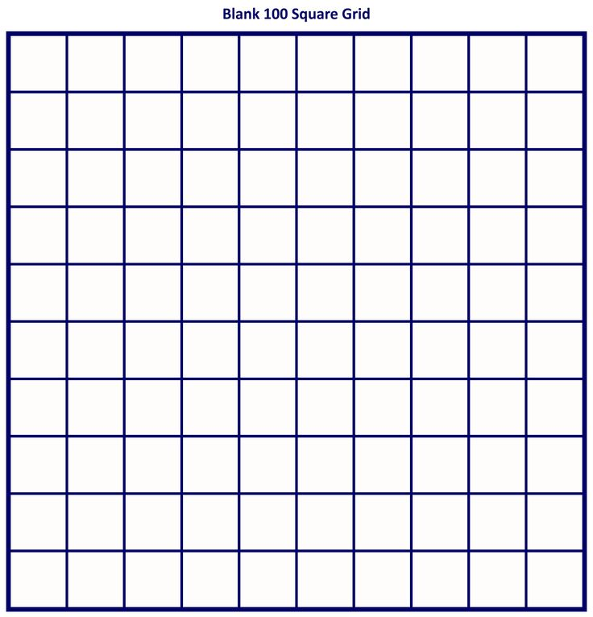

Slide 3


