Slide 1
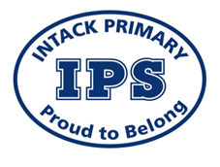
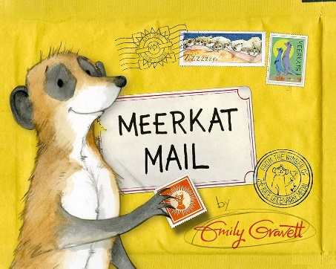
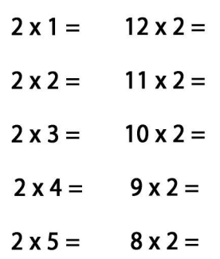
Year 2 Homework due Wednesday 11th February 2026
Curriculum focus for: Spring 1
Maths: Shape and Multiplication and Division English: Non-Fiction: Persuasion Fiction – Meerkat Mail
Science: Animals including Humans Topic: Geography - Let’s go to China
Activity Bank for: Spring 1
Please complete 3 or more activities from the bank. The task marked * MUST BE COMPLETED, plus any three other options.
You can choose when you want to do them. Please write the date they are completed.
Other Essential Home Learning
Read at least 3 times a week using your book in your reading book bag and don’t forget to get an adult to sign your reading record every time you read your book.
Practice counting forwards and backwards from any number up to 100.
Practice your spellings every week.
** ENGLISH ** Using your story map, retell the story of Meerkat Mail to someone in your family. Use actions and expressions when you are telling the story. | ** MATHS ** Draw and write the properties of the following shapes: Circle Triangle Square Rectangle Pentagon Hexagon | ** SCEINCE ** Draw and label the lifecycle of a butterfly. Watch the video to learn more! https://www.youtube.com/watch?v=Zs7UToJLpug
ENGLISH Create a travel guide for Blackburn. Think about what would attract tourists, what could they see and visit? What could they do? Are there places nearby they can visit? Where can they go to eat a nice meal? | MATHS Complete these calculations in your homework book: | TOPIC With a grown-up, write a recipe for one of your favourite meals. Remember to include a title, subheadings and a picture!

