Slide 1
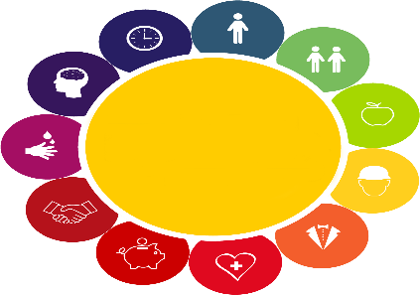




Slide 2
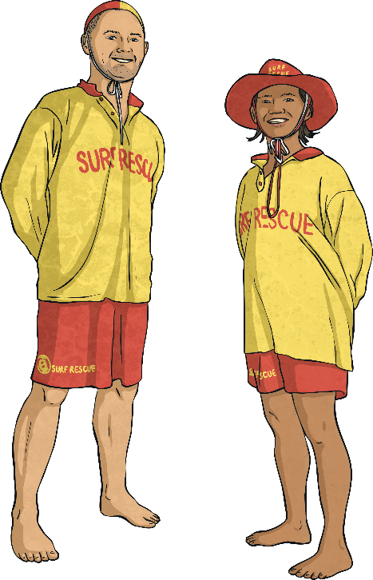
Water Safety
Tell your partner everything you know about staying safe in water.
0
30
30 second timer
There are lots of different ways we can make sure we are safe in any kind of area of water.

Slide 3

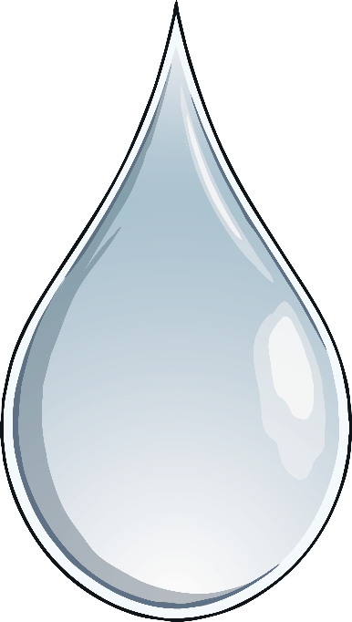
Open Water Safety
When the weather is very hot, open water may be nice to look at but it can be extremely dangerous!
Talk to a partner.
What do you think are the dangers of open water?
How many different kinds of open water can you think of?

Slide 4
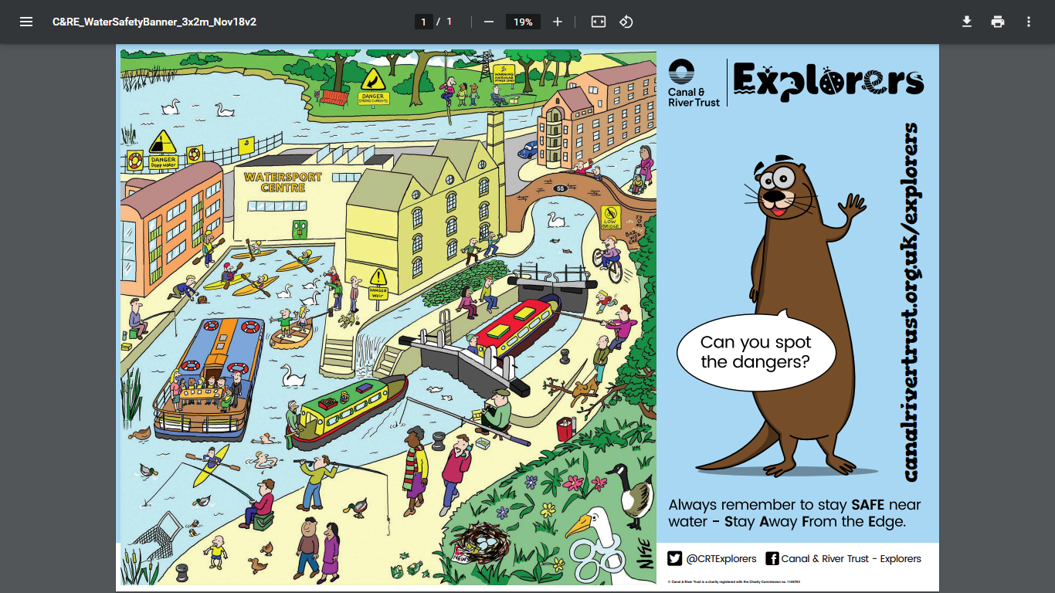

Slide 5
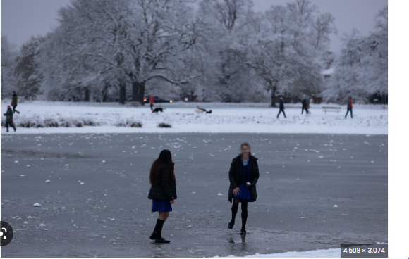
The Dangers of Frozen Water

Slide 6


Slide 7
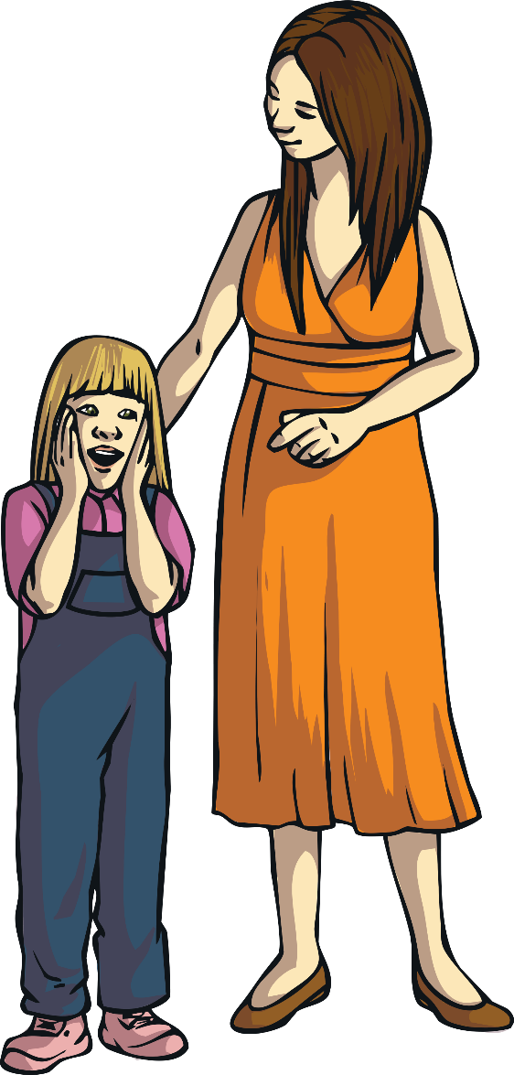

Open Water Safety
Open water means any open body of water, such as ponds, lakes, rivers, canals or reservoirs.
There are ways to stay safe around open water:
Do not jump into open water.
Stay Away From the Edge!
Be careful when playing near open water.
You could fall in and go into cold water shock.
Many people have died as a result of falling into open water.

Slide 8
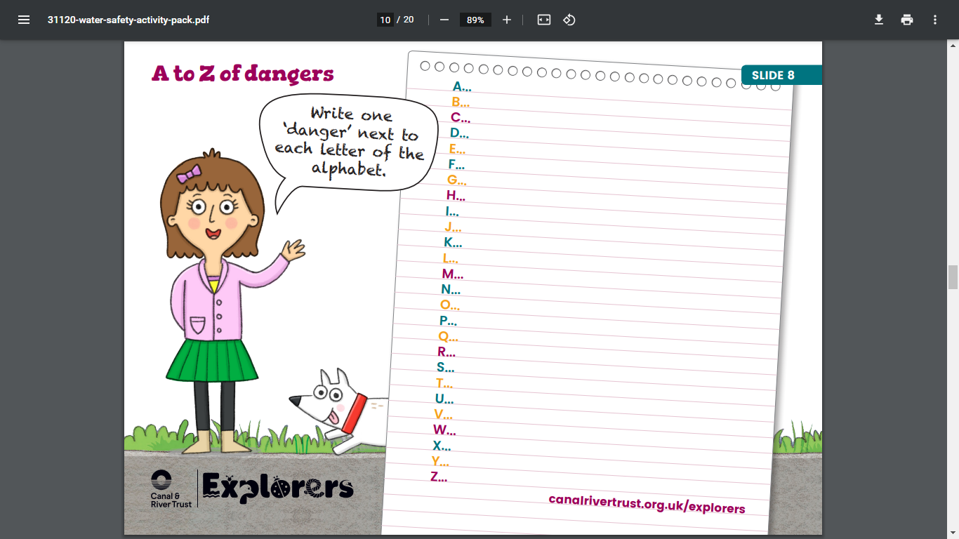

Slide 9
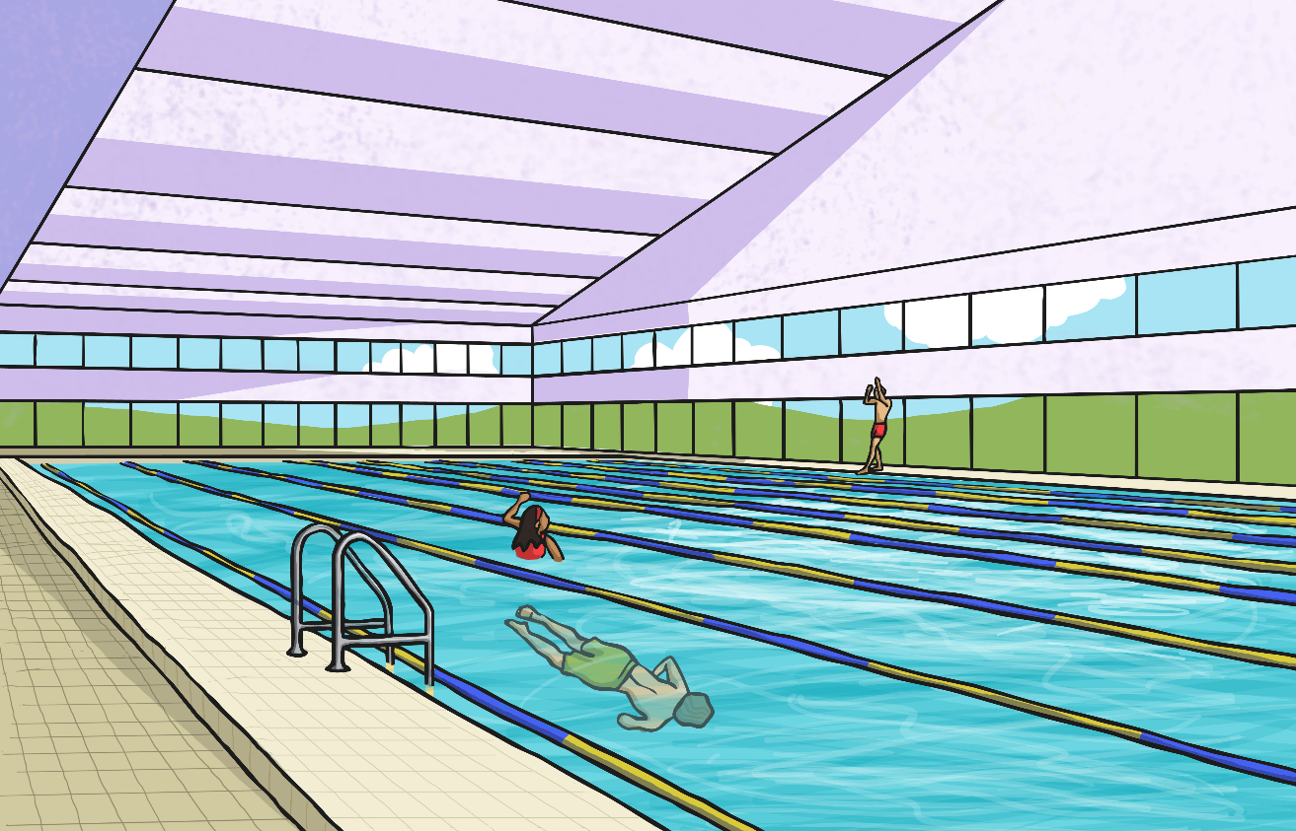
Swimming Pools
There are many ways to stay safe at the swimming pool. Firstly, check out the safety posters you will see all around the pool. These will give you lots of safety tips.

Slide 10
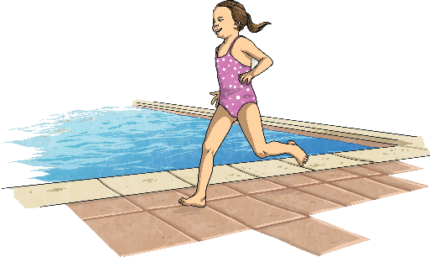
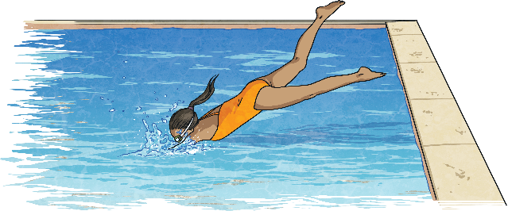
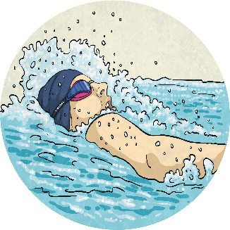
Swimming Pools
Don’t run around the poolside. The floor is wet and you could easily slip and land on the tiled floor.
Do not dive into a pool unless the signs say you can. Diving into water that is shallow can cause serious injury.
Unless you are a strong swimmer, don’t go out of your depth.

Slide 11
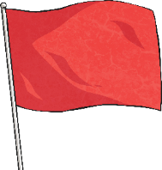
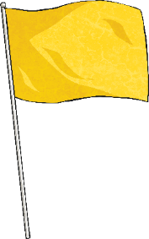

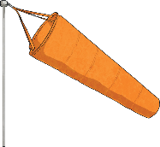
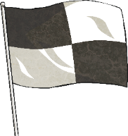
In the Sea
Many beaches have flags which will help you stay safe in the sea. Click to find out what each flag means.
Do not swim.
Take care when swimming here.
Dangerous wind conditions; do not use inflatables or a dinghy.
Swim between these flags.
Do not swim here as the area is being used by surfers.

Slide 12
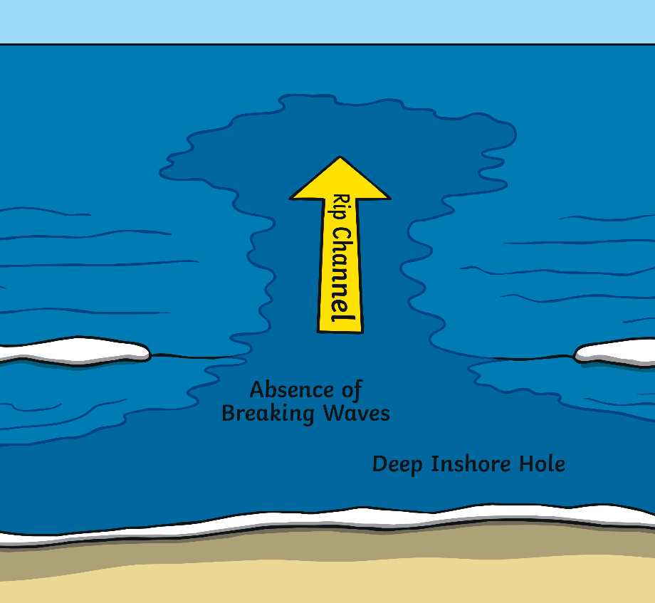
In the Sea
There are other ways to stay safe in the sea.
This shows a rip current. A rip current is a strong flow of water that can quickly carry a person far out to sea. You can often spot a rip current because it looks like a channel of water separate to the usual waves crashing on the shore.
If you get caught in a rip current, don’t try to swim against it. If you can stand up, wade through the water. If you are out of your depth, swim alongside the shoreline until you get out of the rip current.

Slide 13
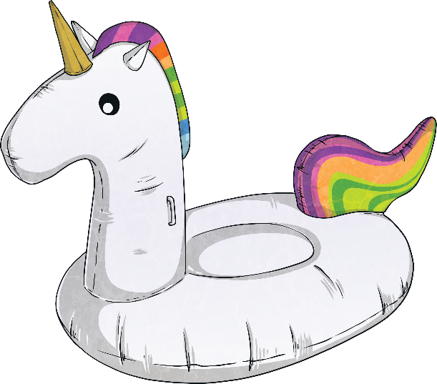
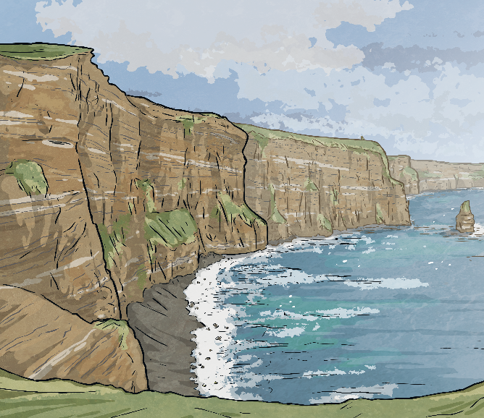
In the Sea
As fun as they seem, inflatables aren’t safe to use in the sea. It only takes one gust of wind to be blown far out to sea. The Royal Life Saving Society UK suggests that they are only used in confined water.
There is currently a trend for people to jump from big heights (such as cliffs) into the sea. This is sometimes called tombstoning. This is extremely dangerous. Jumping from a great height could cause injury on impact with the water. The depth of the water could be unknown, and jumping into shallow water could also cause injury. People have been seriously injured and even killed tombstoning.

Slide 14
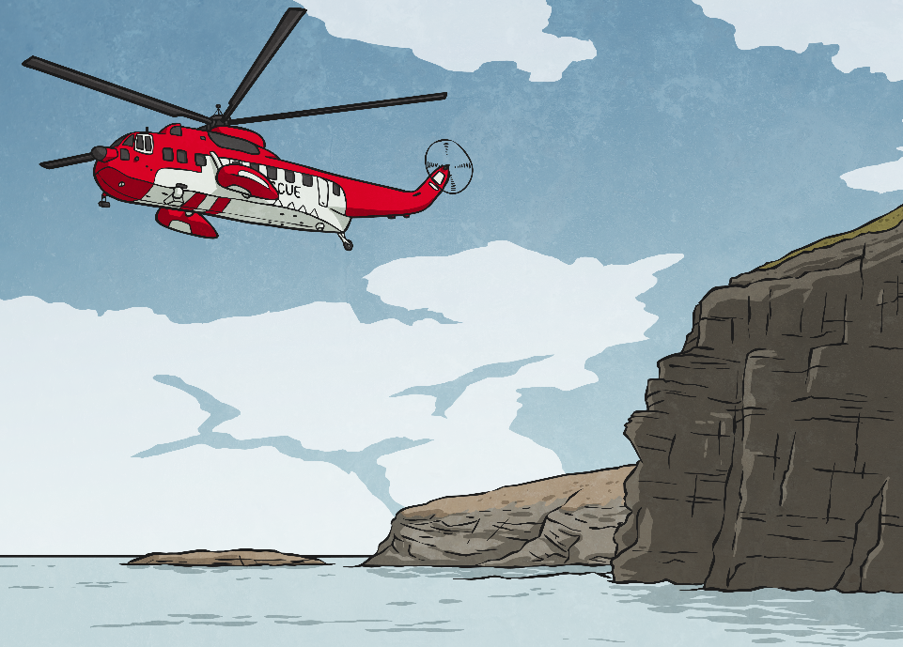
The Emergency Services
Talk About It
What are the emergency services?
Police
Fire service
Emergency medical services (ambulance)
If you are on the coast, another emergency service you can call is the coastguard.
All these emergency services can be contacted by phoning 999 or 112.

